Slide 1



Multithreading: shooting in the leg
Stanislav I. Protasov 22/07/2015

Slide 2

Agenda
Refreshing
Processes, threads and cores
Data races
Dealing with shared resources: Locks and Atomics
Design errors
Lock contention and scalability
ABA problem
Dead-or-alive locks
Lost signals and abandoned locks
Optimization
Volatile
Barriers
Notes:
Lost signals and abandoned locks – mixing strategies

Slide 3


Tasks, threads and cores
Core is logically independent processor unit, that reads and executes program instructions
Task is a program being executed. Also called process
Interrupts
Schedulers
Hyper threading
Thread is smallest sequence of instructions executed on single core and managed by scheduler
Notes:
Processor – executes instructions
Task – program. Multitasking – easily. DIRAC-25 – story of data race
THREADS – PARALLEL VS CONCURRENT VS MULTITHEAD…

Slide 4
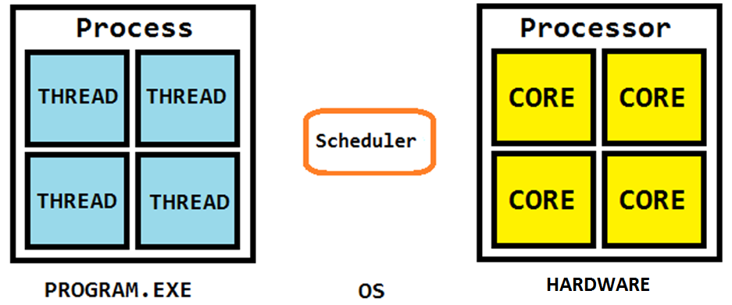
Tasks, threads and cores

Slide 5
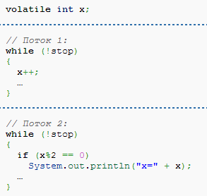
Shared memory problem: data race
Race condition – a condition in program execution, when program’s result depends on instruction execution order AND breaks logics
At least 1 thread should MODIFY the data
Notes:
Hiesenbugs
It is RESOURCE access modification – at least 1 thread should be modifying

Slide 6
Data race: how to fight
Fighting race condition…
Using caching
int x_cached = x; if (x_cached % 2 == 0) System.out.println(“x=” + x_cached);
Using Locks (mutexes, monitors, …)
synchronized keyword
lock.lock() / monitor.wait()
Using atomic operations
AtomicInteger class, …
Notes:
If (x%2 == 0) System.out.println(x);
What is lock

Slide 7
Lock contention
Lock contention – lack of scalability due to bad parallel design
How to fight?
Fine-grained beats Coarse-grained
Natural parallelism
Lock scalability :(

Slide 8

Lock scalability
TAS lock
TTAS lock
Ideal
time
threads
Notes:
Local spinning
Cache, …

Slide 9
ABA problem
ABA problem – using pointers to compare objects leads to the problem of object replacement/removal
Generic problem (N/A to Java)
“Own GC” problem (Lazy methods)
Marked references
Hazard Pointers
Notes:
Generic problem – another object is created on place of the other
A -> B -> C -> D
Go B and sleep
Delete C then B (move to GC trash list)
For HP – only some theads can modify pointer variables. Others not

Slide 10

Dead lock
Mutex (lock) gives us opportunity to wait for some resource eternally. But what will happen, if there are 2+ threads and 2+ resources?

Slide 11

Live lock
Situation, when being polite is not good. Letting other thread to go first leads to live lock

Slide 12
Lost signal (wakeup) and
Abandoned locks
Lost signal: notifyAll() called before you started to wait
Abandoned lock: something went wrong BEFORE you’ve sent notifyAll()
Notes:
Easy when you use lock objects and monitors
Hard when using synchronized

Slide 13
Optimization is your enemy (sometimes)
Compiler optimization reorders instructions considering methods in single-thread environment
volatile keyword
Memory barrier (fence)
Notes:
More importantly, the javac compiler does not perform simple optimizations like loop unrolling, algebraic simplification, strength reduction, and others. To get these benefits and other simple optimizations, the programmer must perform them on the Java source code and not rely on the javac compiler to perform them.
Easy when you use lock objects and monitors
Hard when using synchronized

Slide 14


Your questions, please!
s.protasov@innopolis.ru
http://postnauka.ru/author/protasov

